Slide 1
GLCA-Analytics Program
4-May-2023-Day2PW

Slide 2
Agenda
Intro to Statistics
Measures of Central Tendency
Measures of Dispersion
Measures of Symmetry
Normal Distribution

Slide 3
Statistics
The science of collectiong, organizing, presenting, analyzing, and interpreting data to assist in making more effective decisions
Statistical analysis – used to manipulate summarize, and investigate data, so that useful decision-making information results.

Slide 4
Examples of Statistics
Weather?
Credit Card Fraud Detection?
Basic Decisions we take in life
Sports is highly driven by statistics
R&D of various fields, Govts have Stat Departments
Simulation , Gaming industry
Finance
Election Results Prediction(Exit Poll), Sampling

Slide 5
Types of statistics
Descriptive statistics – Methods of organizing, summarizing, and presenting data in an informative way
Inferential statistics – The methods used to determine something about a population on the basis of a sample
Population –The entire set of individuals or objects of interest or the measurements obtained from all individuals or objects of interest
Sample – A portion, or part, of the population of interest

Slide 6
Descriptive Statistics
Collect data
e.g., Survey
Present data
e.g., Tables and graphs
Summarize data
e.g., Sample mean =

Slide 7
Data
Statistical data are usually obtained by counting or measuring items. Most data can be put into the following categories:
Qualitative - data are measurements that each fail into one of several categories. (hair color, ethnic groups and other attributes of the population)
quantitative - data are observations that are measured on a numerical scale (distance traveled to college, number of children in a family, etc.)

Slide 8
Types of variables
Variables
Qualitative
Quantitative
Dichotomic
Polynomic
Discrete
Continuous
Gender, marital status
Brand of Pc, hair color
Children in family, Strokes on a golf hole
Amount of income tax paid, weight of a student

Slide 9
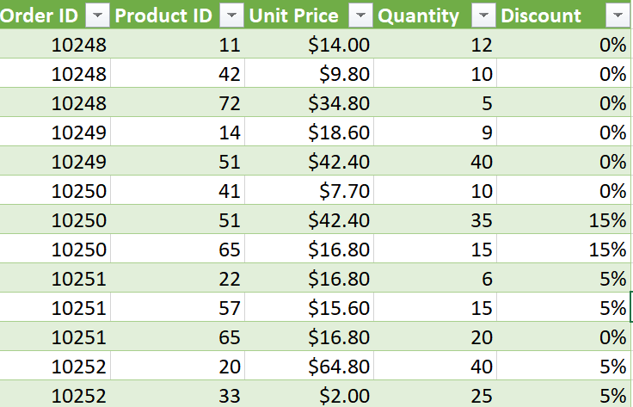
Descriptive Statistics
DS helps us to Describe, summarize, organize data through Numbers or Charts
Measures of Central Tendency - > What single Value can best represent data?
Measures of Dispersion -> How is the variation in the data?
Measures of Symmetry -> What is the shape of the data
Mean. Price?
How price varies from Mean. Price?
Is the data symmetrical?
Is the order close/far from mean price?

Slide 10
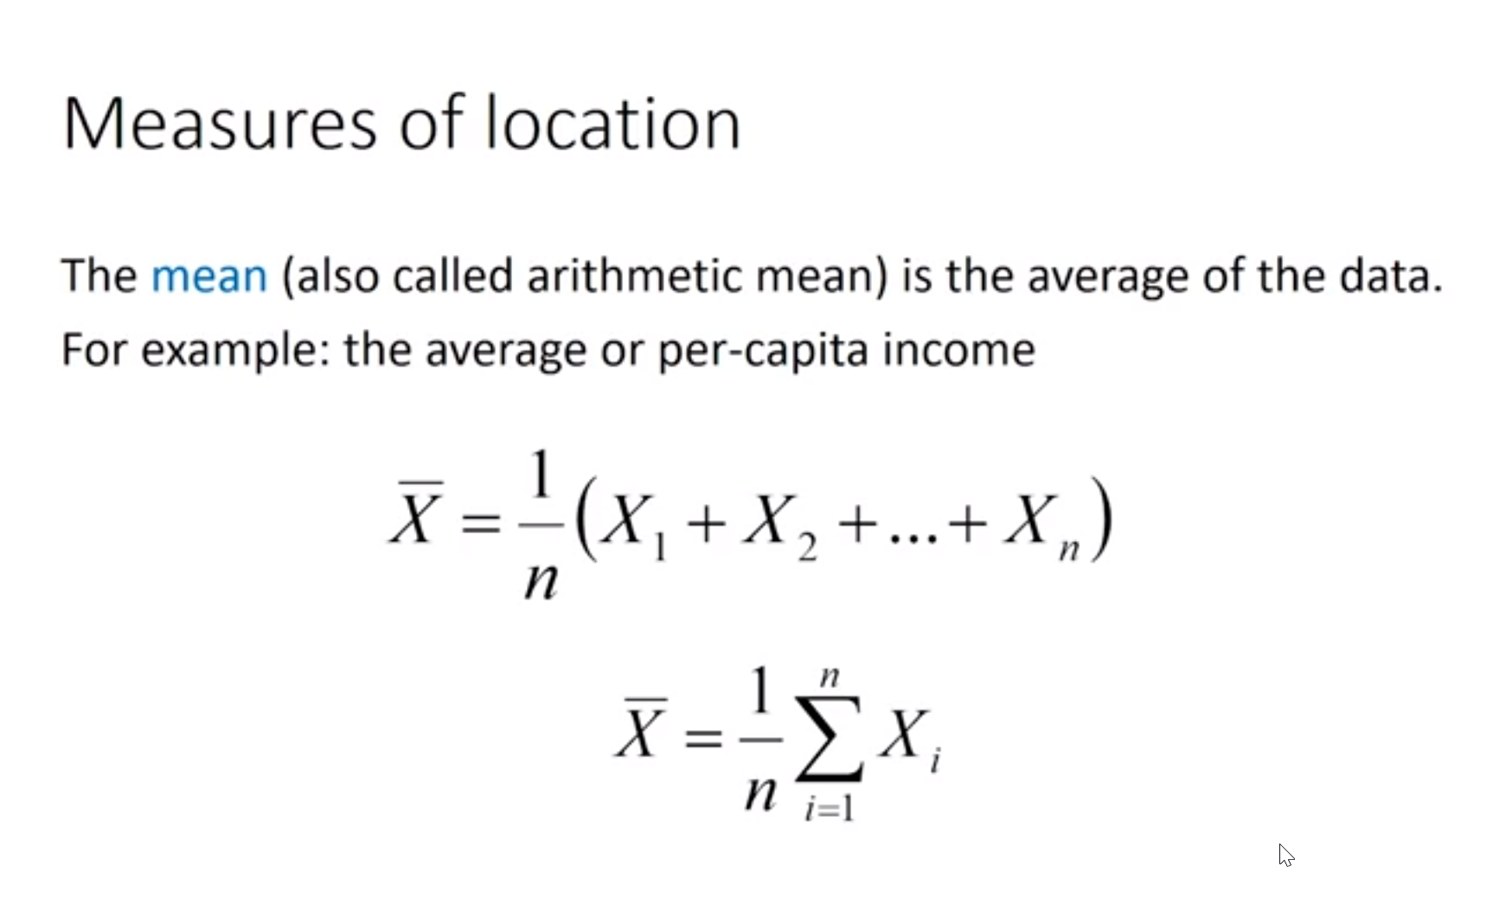

Slide 11
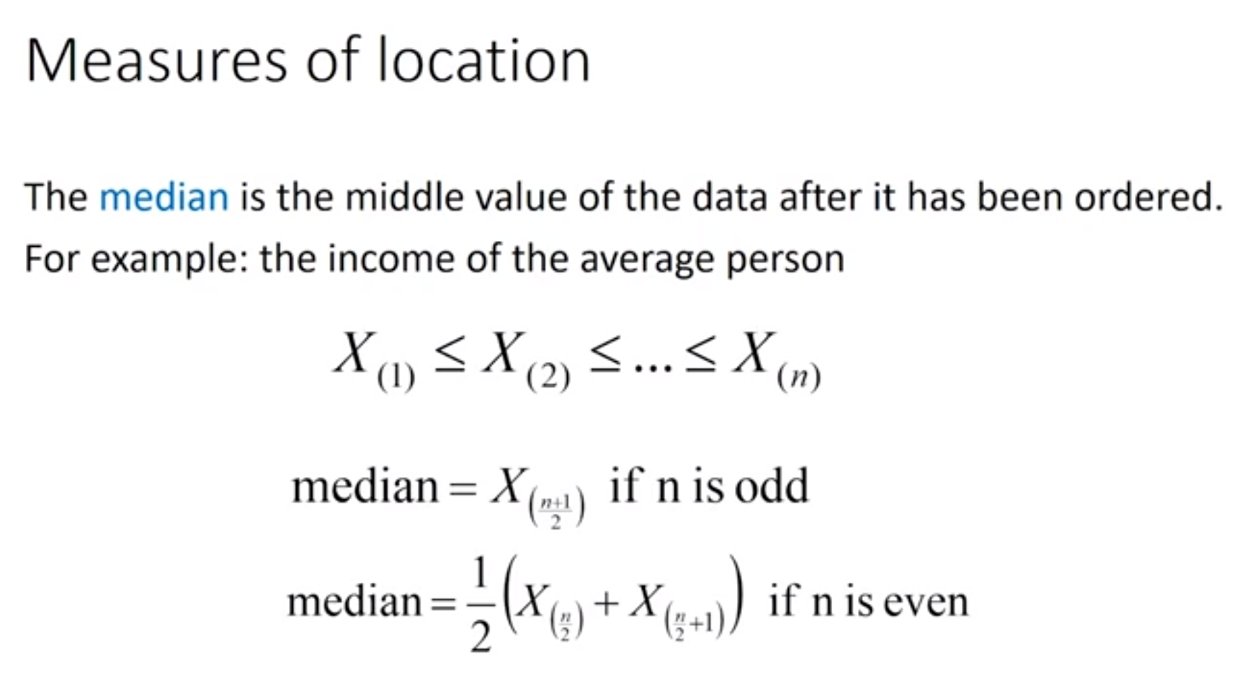

Slide 12
